Slide 1
TITLE:INTELLIGENT ROBOT USING IBM WATSON SERVICES TEAM NAME:FIX IT IOT
DONE BY
S.Pranavi
A.Shreya
V.Jahnavi

Slide 2
ABSTRACT
In this project we are connecting a robot to IBM Watson Services and from those services we can control the robot. We can create a user interface in the Watson services. From that app we can control the robot and we can move that left, right ,forward and backward by simply giving the voice commands. Watson conversation services are used to interact with the robot.

Slide 3
BLOCK DIAGRAM OF MOBILE ROBOT CONTROL SYSTEM
DC MOTOR
VEHICLE
DYNAMICS
MOTOR DRIVER
NODE MCU
DC MOTOR

Slide 4
HARDWARE COMPONENTS
RC CAR
NODE MCU
MOTOR DRIVER

Slide 5
SOFTWARE COMPONENTS
NODE RED
ARDUINO IDE
IBM WATSON PLATFORM

Slide 6
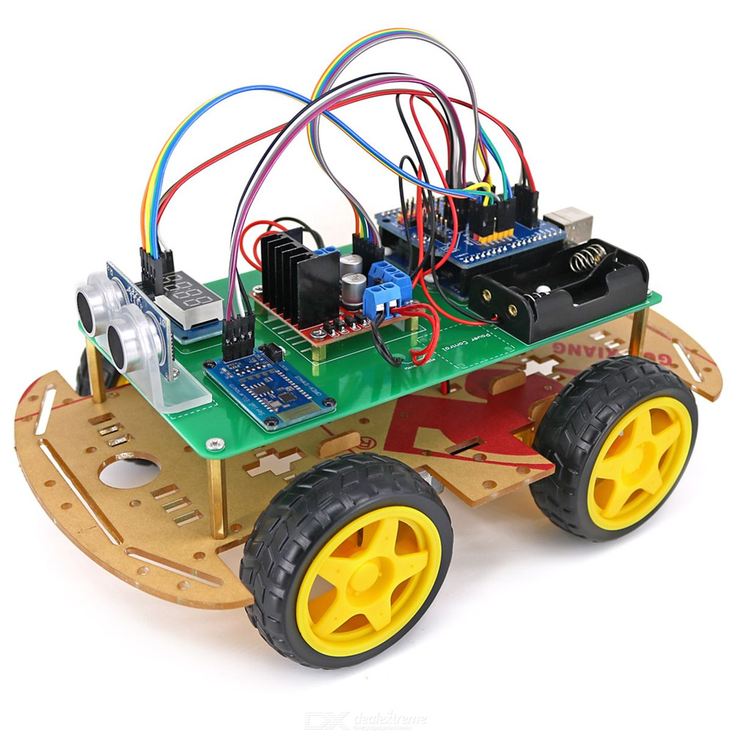
RC CAR

Slide 7
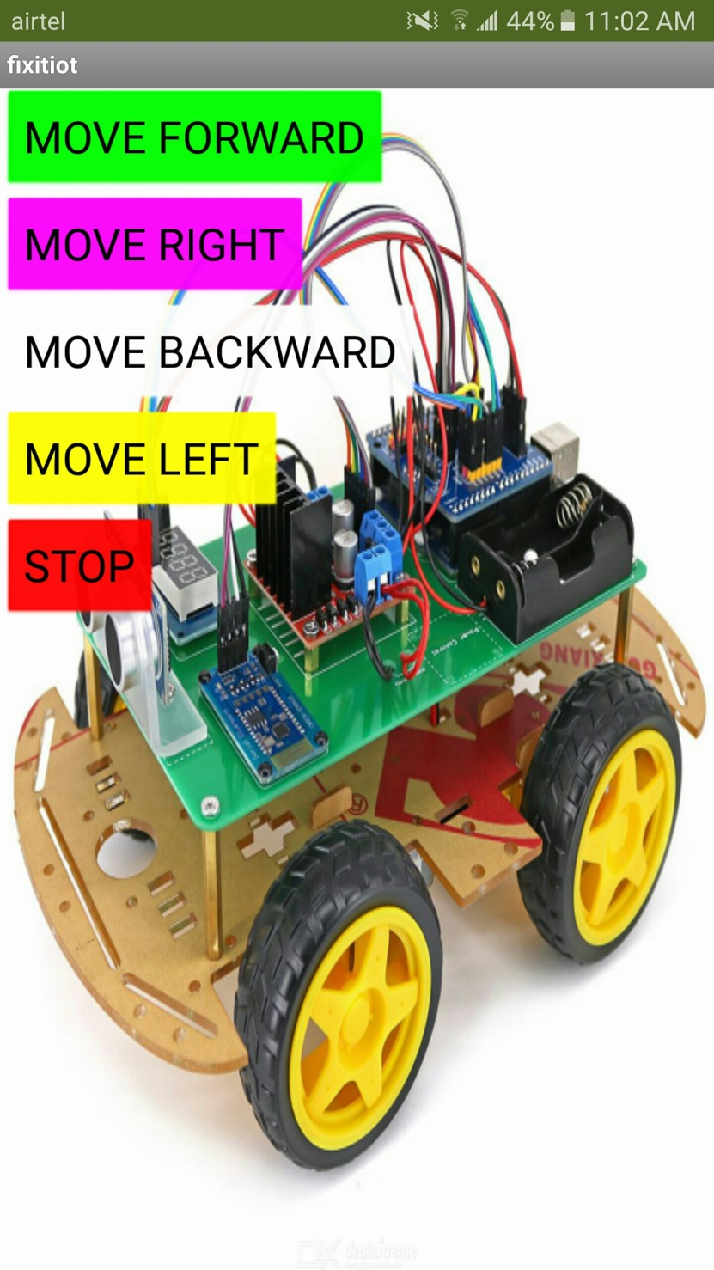

Slide 8
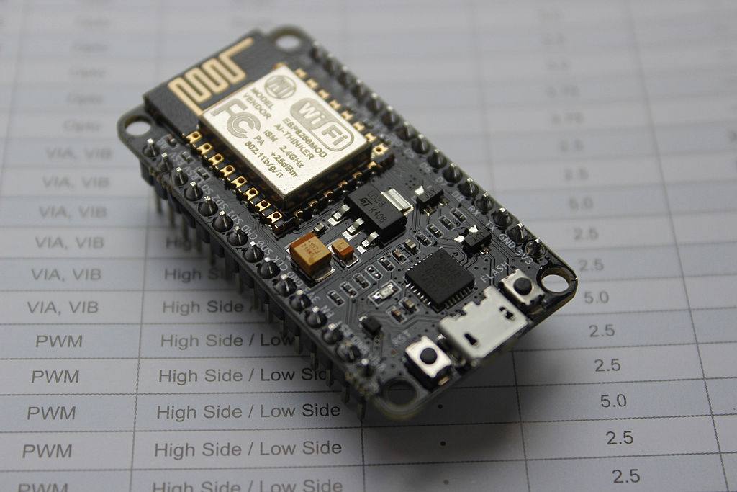
WORKING PRINCIPLE:
1.Node MCU is an open source IOT platform. It includes firmware which runs on the ESP8266 Wi-Fi SOC from ESPRESSIF systems, and hardware which is based on the ESP-12 module. The term "Node MCU" by default refers to the firmware rather than the development kits.

Slide 9
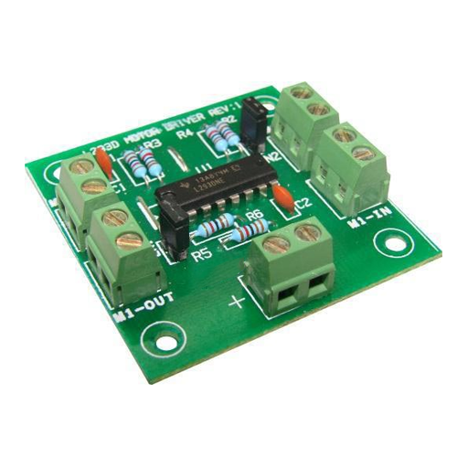
2.L293D Motor Driver IC. L293D IC is a typical Motor Driver IC which allows the DC motor to drive on any direction. ... This L293D IC works on the basicprinciple of H-bridge, this motor control circuit allows the voltage to be flowing in any direction.

Slide 10
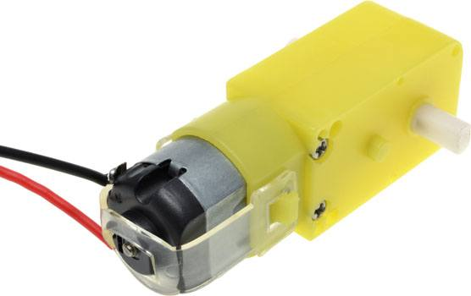
3.Working Principle of a DC Motor. The DC motor is the device which converts the direct current into the mechanical work. It works on the principle of Lorentz Law, which states that “the current carrying conductor placed in a magnetic and electric field experience a force”. And that force is called the Lorentz force.

Slide 11
APPLICATION:
VACUUM CLEANER
How is it used?
By placing a small vacuum or by attaching a sponge , it can be used as vacuum cleaner.

Slide 12
THANKYOUU..!

